Slide 1
Multi-core Computing Lecture 3 MADALGO Summer School 2012 Algorithms for Modern Parallel and Distributed Models
Phillip B. Gibbons
Intel Labs Pittsburgh
August 22, 2012

Slide 2
Multi-core Computing Lectures: Progress-to-date on Key Open Questions
How to formally model multi-core hierarchies?
What is the Algorithm Designer’s model?
What runtime task scheduler should be used?
What are the new algorithmic techniques?
How do the algorithms perform in practice?

Slide 3
Lecture 1 & 2 Summary
Multi-cores: today, future trends, challenges
Computations & Schedulers
Cache miss analysis on 2-level parallel hierarchy
Low-depth, cache-oblivious parallel algorithms
Modeling the Multicore Hierarchy
Algorithm Designer’s model exposing Hierarchy
Quest for a Simplified Hierarchy Abstraction
Algorithm Designer’s model abstracting Hierarchy
Space-Bounded Schedulers

Slide 4
Lecture 3 Outline
Cilk++
Internally-Deterministic Algorithms
Priority-write Primitive
Work Stealing Beyond Nested Parallelism
Other Extensions
False Sharing
Work Stealing under Multiprogramming
Emerging Memory Technologies

Slide 5
Multicore Programming using Cilk++
Cilk extends the C language with just a handful of keywords
Every Cilk program has a serial semantics
Not only is Cilk fast, it provides performance guarantees based on performance abstractions
Cilk is processor-oblivious
Cilk’s provably good runtime system automatically manages low-level aspects of parallel execution, including protocols, load balancing, and scheduling
Intel® Cilk™ Plus
Slides adapted from C. Leiserson’s

Slide 6
Cilk++ Example: Fibonacci
int fib (int n) {
if (n<2) return (n);
else {
int x,y;
x = fib(n-1);
y = fib(n-2);
return (x+y);
}
}
Cilk code
int fib (int n) {
if (n<2) return (n);
else {
int x,y;
x = cilk_spawn fib(n-1);
y = cilk_spawn fib(n-2);
cilk_sync;
return (x+y);
}
}
C elision
Cilk is a faithful extension of C. A Cilk program’s serial elision is always a legal implementation of Cilk semantics. Cilk provides no new data types.

Slide 7
Basic Cilk++ Keywords
int fib (int n) {
if (n<2) return (n);
else {
int x,y;
x = cilk_spawn fib(n-1);
y = cilk_spawn fib(n-2);
cilk_sync;
return (x+y);
}
}
The named child Cilk procedure can execute in parallel with the parent caller
Control cannot pass this point until all spawned children have returned
Useful macro: cilk_for for recursive spawning of parallel loop iterates

Slide 8
Nondeterminism in Cilk
Cilk encapsulates the nondeterminism of scheduling, allowing average programmers to write deterministic parallel codes using only 3 keywords to indicate logical parallelism
The Cilkscreen race detector offers provable guarantees of determinism by certifying the absence of determinacy races
Cilk’s reducer hyperobjects encapsulate the nondeterminism of updates to nonlocal variables, yielding deterministic behavior for parallel updates
See next slide

Slide 9
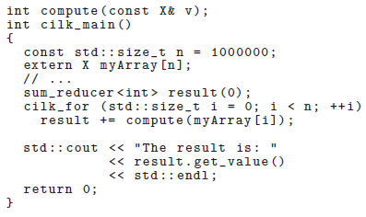
Summing Numbers in an Array using sum_reducer [Frigo et al. ‘09]

Slide 10
Lecture 3 Outline
Cilk++
Internally-Deterministic Algorithms
Priority-write Primitive
Work Stealing Beyond Nested Parallelism
Other Extensions
False Sharing
Work Stealing under Multiprogramming
Emerging Memory Technologies

Slide 11
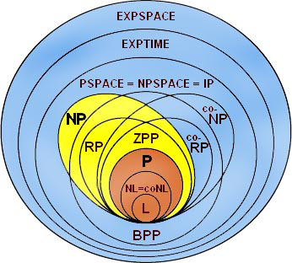
Nondeterminism
X
X
X
Concerned about nondeterminism due to parallel scheduling orders and concurrency
Slides adapted from J. Shun’s
Notes:
Up to a level of abstraction, mention random numbers

Slide 12
Nondeterminism is problematic
Debugging is painful
Hard to reason about code
Formal verification is hard
Hard to measure performance
“Insanity: doing the same thing over and over again and expecting different results.”
- Albert Einstein
Notes:
Concerned about nondeterminism caused by scheduling orders and concurrency

Slide 13
Inherently Deterministic Problems
Breadth first search | Spanning forest
Suffix array | Minimum spanning forest
Remove duplicates | Maximal Independent set
Comparison sort | K-nearest neighbors
N-body | Triangle ray intersect
Delaunay triangulation | Delaunay refinement
Wide coverage of real-world non-numeric problems
Random numbers can be deterministic
Notes:
The problems are inherently deterministic (once we fix the random numbers), but many parallel implementations make them so they are not deterministic. Mention next talk is about generating random numbers in parallel deterministically.

Slide 14
External vs. Internal Determinism
External: same input → same result
Internal: same input → same intermediate states & same result
Notes:
Up to a level of abstraction. Problems before might also be internally deterministic

Slide 15
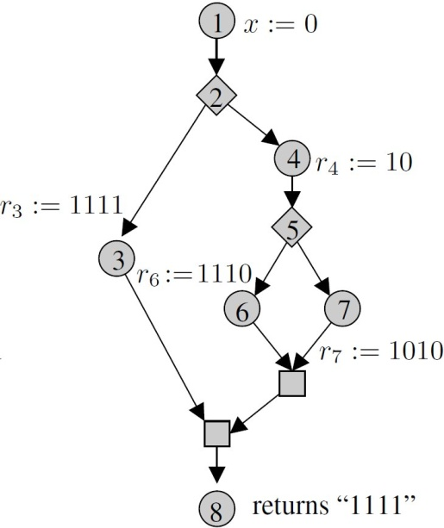
Internal Determinism [Netzer, Miller ’92]
Trace
Trace: a computation’s final state, intermediate states, and control-flow DAG
Internally deterministic: for any fixed input, all possible executions result in equivalent traces (w.r.t. some level of abstraction)
Also implies external determinism
Provides sequential semantics
↓
Notes:
Sequential semantics: considering any sequential traversal of the control-flow DAG is sufficient for analyzing the correctness of the code

Slide 16
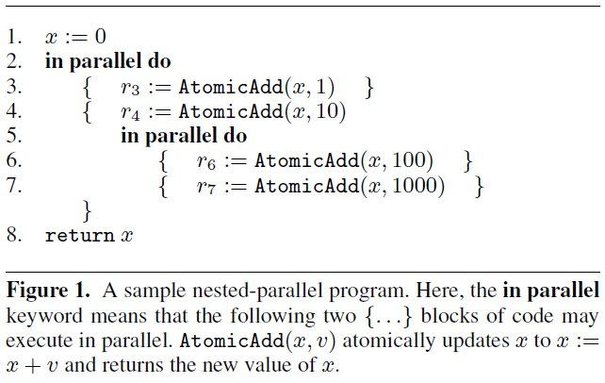
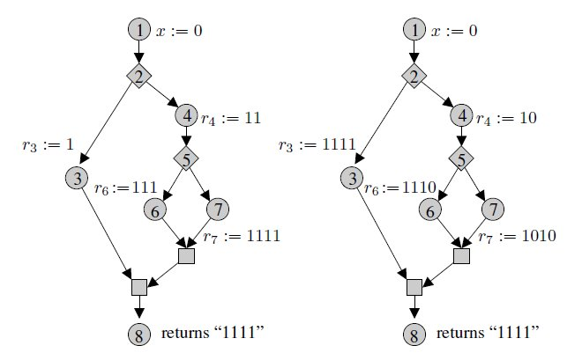
Internally deterministic?
Notes:
Say internal determinism is deterministic only with respect to operations at our level of abstraction

Slide 17
Commutative + Nested Parallel → Internal Determinism [Steele ‘90]
Commutativity
[Steele ’90] define it in terms of memory operations
[Cheng et al. ’98] extend it to critical regions
Two operations f and g commute if f ◦ g and g ◦ f have same final state and same return values
We look at commutativity in terms of arbitrary abstraction by introducing “commutative building blocks”
We use commutativity strictly to get deterministic behavior, but there are other uses…
Notes:
Say what commutativity means: operations commute if they return the same result/state independent of the order. Same return values means…

Slide 18
System Approaches to Determinism
Determinism via
Hardware mechanisms [Devietti et al. ‘11, Hower et al. ‘11]
Runtime systems and compilers [Bergan et al. ‘10, Berger et al. ‘09, Olszewski et al. ‘09, Yu and Narayanasamy ‘09]
Operating systems [Bergan et al. ‘10]
Programming languages/frameworks [Bocchino et al. ‘09]

Slide 19
Commutative Building Blocks [Blelloch, Fineman, G, Shun ‘12]
Priority write
pwrite, read
Priority reserve
reserve, check, checkReset
Dynamic map
insert, delete, elements
Disjoint set
find, link
At this level of abstraction, reads commute with reads & updates commute with updates
Notes:
Checks and check-resets commute with each other
Reserves commute with one another
Checks and reserves do not commute with each other

Slide 20
Dynamic Map
Using hashing:
Based on generic hash and comparison
Problem: representation can depend on ordering. Also on which redundant element is kept.
Solution: Use history independent hash table based on linear probing…once done inserting, representation is independent of order of insertion
7
11
11
11
6
3
9
5
8
Notes:
Once things are inserted, they commute
- Cannot call find and elements in parallel
One application is to list the set of elements in the map
Used for remove duplicates

Slide 21
Dynamic Map
Using hashing:
Based on generic hash and comparison
Problem: representation can depend on ordering. Also on which redundant element is kept.
Solution: Use history independent hash table based on linear probing…once done inserting, representation is independent of order of insertion
7
11
11
11
6
3
9
5
8
Notes:
Once things are inserted, they commute
- Cannot call find and elements in parallel
One application is to list the set of elements in the map
Used for remove duplicates

Slide 22
Internally Deterministic Problems
Functional programming
Suffix array
Comparison sort
N-body
K-nearest neighbors
Triangle ray intersect
History-independ. data structures
Remove duplicates
Delaunay refinement
Deterministic reservations
Spanning forest
Minimum spanning forest
Maximal independent set
Breadth first search
Delaunay triangulation
Delaunay refinement
Notes:
Make sure the algorithm using the data structure calls the operations in the right way (so that they commute). Say how remove duplicates works

Slide 23
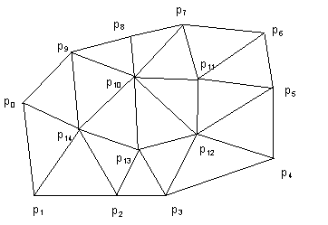
Delaunay Triangulation/Refinement
Incremental algorithm adds one point at a time, but points can be added in parallel if they don’t interact
The problem is that the output will depend on the order they are added.
Notes:
Note: define problem?
Note: will be external in the end
Locks in implementation can lead to nondeterminism

Slide 24
Delaunay Triangulation/Refinement
Adding points deterministically

Slide 25
Delaunay Triangulation/Refinement
Adding points deterministically

Slide 26
Delaunay Triangulation/Refinement
Adding points deterministically
16
17

Slide 27
Delaunay Triangulation/Refinement
Adding points deterministically
16
16
16
17
16
17
16
17
16

Slide 28
Delaunay Triangulation/Refinement
Adding points deterministically
16
16
16
17
16
17
16
17
16

Slide 29
Deterministic Reservations
Generic framework
Delaunay triangulation/refinement
iterates = [1,…,n];
while(iterates remain){
Phase 1: in parallel, all i in iterates call reserve(i);
Phase 2: in parallel, all i in iterates call commit(i);
Remove committed i‘s from iterates;
}
Note: Performance can be improved by processing prefixes of iterates in each round
reserve(i){
find cavity;
reserve points in cavity; }
commit(i){
check reservations;
if(all reservations successful){
add point and triangulate;
}
}
Notes:
Mention prefixes at all? Drop prefix thing. Make code more in English. Picture? Smaller version of delaunay triangulation

Slide 30
Internally Deterministic Code
Implementations of benchmark problems
Internally deterministic
Nondeterministic
Sequential
All require only 20-500 lines of code
Use nested data parallelism
Used library of parallel operations on sequences: reduce, prefix sum, filter, etc.

Slide 31
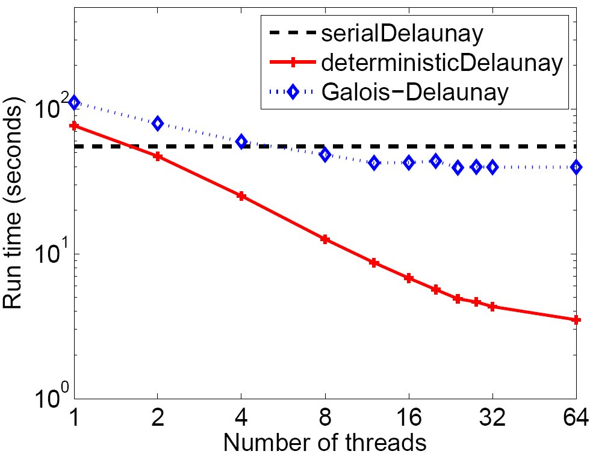
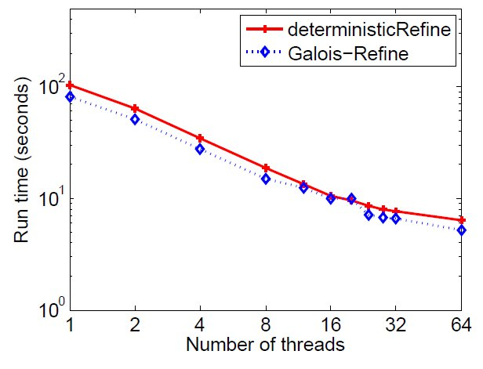
Experimental Results
Delaunay Triangulation
Delaunay Refinement
32-core Intel Xeon 7500 Multicore
Input Sets: 2M random points within a unit circle &
2M random 2D points from the Kuzmin distribution
Notes:
Triangulation: we are faster due to a more efficient point-location structure
Refine: Galois-Refine does not include the time for computing triangle neighbors and initial bad triangles at the beginning (takes 10-15% of the overall time)

Slide 32
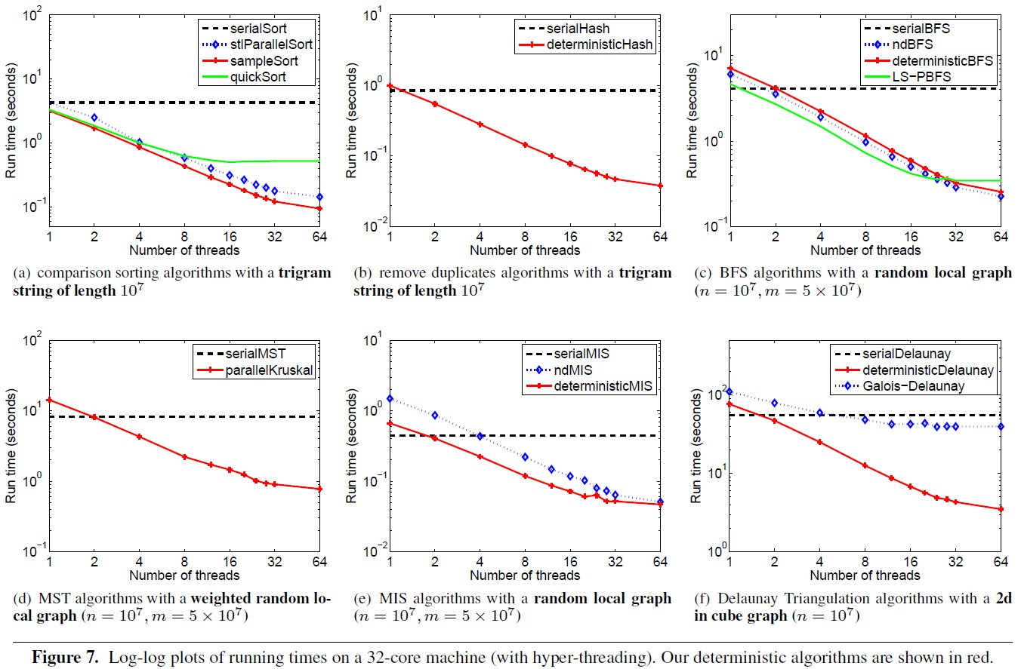
Experimental Results
Notes:
MENTION LOG-LOG PLOT
Mention STL sort by Sander’s research group in Germany – winner of many sorting benchmark contests

Slide 33
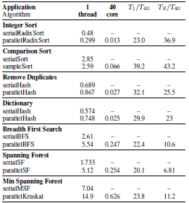
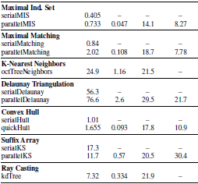
Speedups on 40-core Xeon E7-8870

Slide 34
Problem Based Benchmark Suite http://www.cs.cmu.edu/~pbbs/
Goal: A set of “problem based benchmarks” Must satisfy a particular input-output interface, but there are no rules on the techniques used
Measure the quality of solutions based on:
Performance and speedup over a variety of input types and w.r.t. best sequential implementations
Quality of output. Some benchmarks don’t have a right answer or are approximations
Complexity of code. Lines of code & other measures
Determinism. The code should always return the same output on same input
Generic. Code should be generic over types
Correctness guarantees
Easily analyze performance, at least approximately

Slide 35
Lecture 3 Outline
Cilk++
Internally-Deterministic Algorithms
Priority-write Primitive
Work Stealing Beyond Nested Parallelism
Other Extensions
False Sharing
Work Stealing under Multiprogramming
Emerging Memory Technologies

Slide 36
Priority Write as a Parallel Primitive [Shun, Blelloch, Fineman, G]
Priority-write: when there are multiple writes to a location, possibly concurrently, the value with the highest priority is written
E.g., write-with-min: for each location, min value written wins (used earlier in Delaunay Refinement)
Useful parallel primitive:
+ Low contention even under high degrees of sharing
+ Avoids many concurrency bugs since commutes
+ Useful for many algorithms & data structures
A := 5 B := 17 B := 12 A := 9 A := 8
yields A = 5 and B = 12

Slide 37
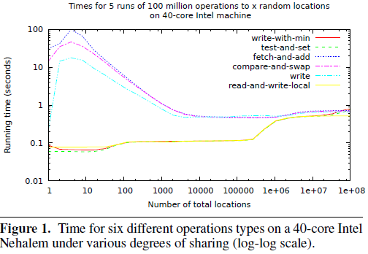
Priority-Write Performance
Similar results on 48-core AMD Opteron 6168

Slide 38
Theoretical Justification
Lemma: Consider a collection of n distinct priority-write operations to a single location, where at most p randomly selected operations occur concurrently at any time. Then the number of CAS attempts is O(p ln n) with high probability.
Idea: Let X_k be an indicator for the event that the kth priority-write performs an update. Then X_k = 1 with probability 1/k, as it updates only if it is the highest-priority of all k earliest writes. The expected number of updates is then given by E[X_1+ … +X_n] = 1/1+1/2+1/3+... +1/n = H_n.

Slide 39
Priority-Write in Algorithms
Take the maximum/minimum of set of values
Avoiding nondeterminism since commutative
Guarantee progress in algorithm: highest priority thread will always succeed
Deterministic Reservations: speculative parallel FOR loop (use iteration as priority)

Slide 40
Priority Writes in Algorithms
Parallel version of Kruskal’s minimum spanning- tree algorithm so that the minimum-weight edge into a vertex is always selected
Boruvka’s algorithm to select the minimum- weight edge
Bellman-Ford shortest paths to update the neighbors of a vertex with the potentially shorter path
Deterministic Breadth-First Search Tree

Slide 41
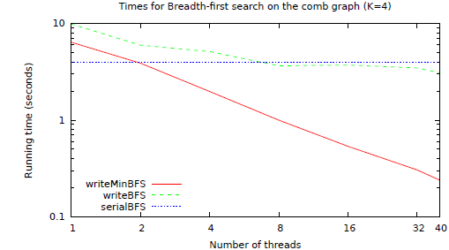
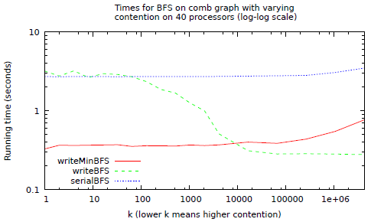
E.g., Breadth-First Search Tree
Frontier = {source vertex}
In each round:
In parallel for all v in Frontier
Remove v;
Attempt to place all v’s neighbors in Frontier;
Input: Comb Graph

Slide 42
Priority-Write Definition

Slide 43
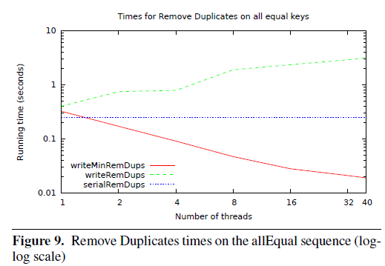
Priority-Writes on Locations
Efficient implementation of a more general dictionary-based priority-write where the writes/inserts are made based on keys.
E.g., all writers might insert a character string into a dictionary with an associated priority
Use for prioritized remove-duplicates algorithm

Slide 44
Lecture 3 Outline
Cilk++
Internally-Deterministic Algorithms
Priority-write Primitive
Work Stealing Beyond Nested Parallelism
Other Extensions
False Sharing
Work Stealing under Multiprogramming
Emerging Memory Technologies

Slide 45
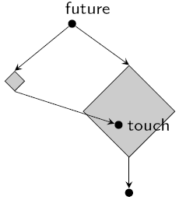
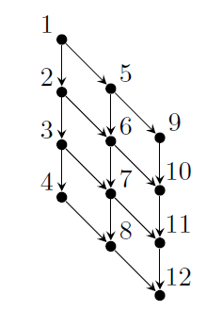
Parallel Futures
Futures [Halstead '85], in Multilisp
Parallelism no longer nested
Here: explicit future and touch keywords
E.g. Halstead's quicksort, pipelining tree merge [Blelloch, Reid-Miller '97]
Strictly more expressive than fork/join
E.g. can express parallel pipelining
… but still deterministic!

Slide 46
Work Stealing for Futures?
Implementation choices:
What to do when touch causes processor to stall?
Previous work beyond nested parallelism:
Bound # of steals for WS [Arora et al. ’98]
We show: not sufficient to bound WS overhead, once add futures!
Summary of previous work
Nested Parallelism: O(Pd) steals, Overheads additive in # of steals
Beyond Nested Parallelism: O(Pd) steals, # steals can’t bound overheads
d = depth of DAG

Slide 47
Bounds for Work Stealing with Futures [Spoonhower, Blelloch, G, Harper ‘09]
Extend study of Work Stealing (WS) to Futures:
Study “deviations” as a replacement for “steals”
Classification of deviations arising with futures
Tight bounds on WS overheads as function of # of deviations
Give tight upper & lower bounds on # of deviations for WS
Θ(Pd + Td), where T is # of touches
Characterize a class of programs using futures effectively
Only O(Pd) deviations

Slide 48
Futures + Parallelism
Processor can stall when:
1. No more tasks in local work queue
2. Current task is waiting for a value computed by another processor
Existing WS only steals in case 1
We call these parsimonious schedulers (i.e., pays the cost of a steal only when it must)
Thus, in case 2, stalled processor jumps to other work on its local work queue

Slide 49
Deviations
A deviation (from the sequential schedule) occurs when...
a processor p visits a node n,
the sequential schedule visits n’ immediately before n
...but p did not.
Used by [Acar, Blelloch, Blumofe ’02] to bound additional cache misses in nested parallelism
Our work: use deviations as means to bound several measures of performance
Bound # of “slow clone” invocations (≈ computation overhead)
Bound # of cache misses in private LRU cache

Slide 50
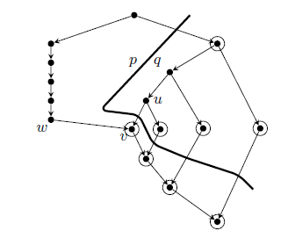
Sources of Deviations
In nested parallelism:
at steals & joins
# deviations ≤ 2× # steals
With futures:
at steals & joins
at touches
indirectly after touches
1
2
7
3
4
8
5
9
6
11
13
touch
15
10
12
14
16
(rest)

Slide 51
Bounding WS Overheads
∆ = # of deviations
Invocations of slow clones
Theorem: # of slow clone invocations ≤ ∆
Lower bound: # of slow clone invocations is Ω(∆)
Cache misses (extension of [Acar, Blelloch, Blumofe ‘02])
Theorem: # of cache misses < Q₁(M) + M ∆
Each processor has own LRU cache; under dag consistency
M = size of a (private) cache
Q₁(M) = # of cache misses in sequential execution

Slide 52
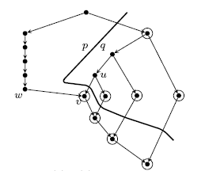
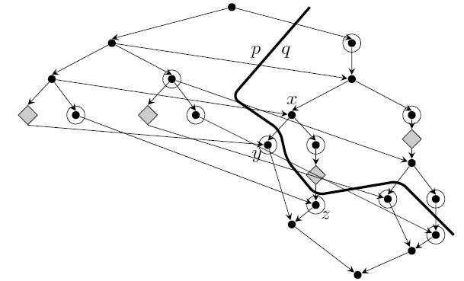
Deviations: Example Graphs
2 processors: p & q
1 future, 1 touch,
1 steal, span=d
Ω(d) deviations
T futures, T touches,
1 steal, O(log T) span
Ω(T) deviations

Slide 53
Bounding Deviations, Upper Bound
Main Theorem:
∀ computations derived from futures with depth d and T touches, the expected # deviations by any parsimonious WS scheduler on P processors is O(Pd + Td)
First term O(Pd) based on previous bound on # of steals
Second term O(Td) from indirect deviations after touches
Proof relies on:
Structure of graphs derived from uses of futures
Behavior of parsimonious WS

Slide 54
Pure Linear Pipelining
Identified restricted use case w/ less overhead
# of deviations is O(Pd)
Includes producer-consumer examples with streams, lists, one-dimensional arrays

Slide 55
Lecture 3 Outline
Cilk++
Internally-Deterministic Algorithms
Priority-write Primitive
Work Stealing Beyond Nested Parallelism
Other Extensions
False Sharing
Work Stealing under Multiprogramming
Emerging Memory Technologies

Slide 56
False Sharing
Slides adapted from V. Ramachandran’s

Slide 57
Block-Resilience [Cole, Ramachandran ‘12]
Hierarchical Balanced Parallel (HBP) computations use balanced fork-join trees and build richer computations through sequencing and recursion
Design HBP with good sequential cache complexity, and good parallelism
Incorporate block resilience in the algorithm to guarantee low overhead due to false sharing
Design resource-oblivious algorithms (i.e., with no machine parameters in the algorithms) that are analyzed to perform well (across different schedulers) as a function of the number of parallel tasks generated by the scheduler

Slide 59
Multiple Work-Stealing Schedulers at Once?
Dealing with multi-tenancy
Want to run at same time
Schedulers must provide throughput + fairness
Failed steal attempts not useful work
Yielding at failed steal attempts leads to unfairness
BWS [Ding et al. ’12] decreases average unfairness from 124% to 20% and increases thruput by 12%
Open: What bounds can be proved?

Slide 60
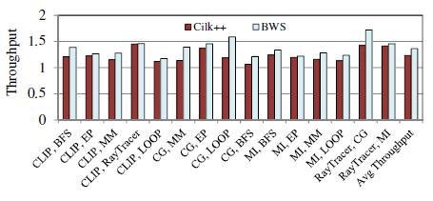
Unfairness
Throughput

Slide 61
Lecture 3 Outline
Cilk++
Internally-Deterministic Algorithms
Priority-write Primitive
Work Stealing Beyond Nested Parallelism
Other Extensions
False Sharing
Work Stealing under Multiprogramming
Emerging Memory Technologies

Slide 62
NAND Flash Chip Properties
Block (64-128 pages)
Page (512-2048 B)
Read/write pages, erase blocks
…
…
Write page once after a block is erased
In-place update
1. Copy
2. Erase
3. Write
4. Copy
5. Erase
Random
Expensive operations:
In-place updates
Random writes
Sequential
Random
Sequential
0.4ms
0.6ms
0.4ms
127ms
Read
Write
These quirks are now hidden by Flash/SSD firmware
Notes:
62

Slide 63
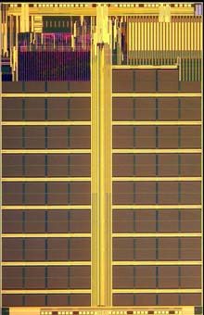
Phase Change Memory (PCM)
Byte-addressable non-volatile memory
Two states of phase change material:
Amorphous: high resistance, representing “0”
Crystalline: low resistance, representing “1”
Operations:
“RESET” to Amorphous
e.g., ~610⁰C
Current (Temperature)
“SET” to Crystalline
e.g., ~350⁰C
READ
Time
Notes:
1’30

Slide 64
Comparison of Technologies
 | DRAM | PCM | NAND Flash
Page size Page read latency Page write latency Write bandwidth Erase latency | 64B 20-50ns 20-50ns ∼GB/s per die N/A | 64B ∼ 50ns ∼ 1 µs 50-100 MB/s per die N/A | 4KB ∼ 25 µs ∼ 500 µs 5-40 MB/s per die ∼ 2 ms
Endurance | ∞ | 10⁶ − 10⁸ | 10⁴ − 10⁵
Read energy Write energy Idle power | 0.8 J/GB 1.2 J/GB ∼100 mW/GB | 1 J/GB 6 J/GB ∼1 mW/GB | 1.5 J/GB [28] 17.5 J/GB [28] 1–10 mW/GB
Density | 1× | 2 − 4× | 4×
Compared to NAND Flash, PCM is byte-addressable, has orders of magnitude lower latency and higher endurance.
Sources: [Doller ’09] [Lee et al. ’09] [Qureshi et al. ‘09]
Notes:
Describe rows (latency & bandwidth, endurance, energy, density)
Comparing PCM and NAND flash, we see that (1) cache line (2) 2-orders of … lower latency, 3 orders of … higher endurance

Slide 65
Comparison of Technologies
 | DRAM | PCM | NAND Flash
Page size Page read latency Page write latency Write bandwidth Erase latency | 64B 20-50ns 20-50ns ∼GB/s per die N/A | 64B ∼ 50ns ∼ 1 µs 50-100 MB/s per die N/A | 4KB ∼ 25 µs ∼ 500 µs 5-40 MB/s per die ∼ 2 ms
Endurance | ∞ | 10⁶ − 10⁸ | 10⁴ − 10⁵
Read energy Write energy Idle power | 0.8 J/GB 1.2 J/GB ∼100 mW/GB | 1 J/GB 6 J/GB ∼1 mW/GB | 1.5 J/GB [28] 17.5 J/GB [28] 1–10 mW/GB
Density | 1× | 2 − 4× | 4×
Compared to DRAM, PCM has better density and scalability; PCM has similar read latency but longer write latency
Sources: [Doller ’09] [Lee et al. ’09] [Qureshi et al. ’09]
Notes:
Higher density if produced for mass market; more scalable: it is still unknown if DRAM can scaled down to 20nm because of technology problems, 9nm PCM prototypes have been demonstrated.

Slide 66
Relative Latencies:
Read
DRAM
PCM
NAND Flash
Hard Disk
10ns
100ns
1us
10us
100us
1ms
10ms
DRAM
PCM
NAND Flash
Hard Disk
Write
Notes:
This is a more intuitive picture comparing the latencies; This is log scale from 10ns to 10ms;

Slide 67
Challenge: PCM Writes
 | PCM
Page size Page read latency Page write latency Write bandwidth Erase latency | 64B ∼ 50ns ∼ 1 µs 50-100 MB/s per die N/A
Endurance | 10⁶ − 10⁸
Read energy Write energy Idle power | 1 J/GB 6 J/GB ∼1 mW/GB
Density | 2 − 4×
Limited endurance
Wear out quickly for hot spots
High energy consumption
6-10X more energy than a read
High latency & low bandwidth
SET/RESET time > READ time
Limited instantaneous electric current level, requires multiple rounds of writes

Slide 68
PCM Write Hardware Optimization
[Cho, Lee’09] [Lee et al. ’09] [Yang et al. ‘07] [Zhou et al. ’09]
Baseline: several rounds of writes for a cache line
Which bits in which rounds are hard wired
Optimization: data comparison write
Goal: write only modified bits rather than entire cache line
Approach: read-compare-write
Skipping rounds with no modified bits
Rounds highlighted w/ different colors
Cache line
0
1
0
1
1
0
0
1
0
1
1
0
0
0
0
1
0
1
0
1
1
0
1
1
0
1
1
0
1
1
1
0
PCM
0
0
1
1
0
0
1
1
1
1
0
0
1
0
0
1
1
0
0
1
1
1
1
0
0
1
0
0
1
0
0
1
0
0
0
1
1
Notes:
WE can further reduce writes in software.

Slide 69
PCM-savvy Algorithms?
New goal: minimize PCM writes
Writes use 6X more energy than reads
Writes 20X slower than reads, lower BW, wear-out
Data comparison writes:
Minimize Number of bits that change

Slide 70
B⁺-Tree Index
Node size 8 cache lines; 50 million entries, 75% full;
Three workloads: Inserting / Deleting / Searching 500K random keys
PTLSSim extended with PCM support
[Chen, G, Nath ‘11]
Total wear
Energy
Execution time
Unsorted leaf schemes achieve the best performance
For insert intensive: unsorted-leaf
For insert & delete intensive: unsorted-leaf with bitmap

Slide 71
Multi-core Computing Lectures: Progress-to-date on Key Open Questions
How to formally model multi-core hierarchies?
What is the Algorithm Designer’s model?
What runtime task scheduler should be used?
What are the new algorithmic techniques?
How do the algorithms perform in practice?

Slide 72
References
[Acar, Blelloch, Blumofe ’02] U. A. Acar, G. E. Blelloch, and R. D. Blumofe. The data locality of work stealing. Theory of Comput. Syst., 35(3), 2002
[Arora et al. ’98] N. S. Arora, R. D. Blumofe, and C. G. Plaxton. Thread scheduling for multiprogrammed multiprocessors. ACM SPAA, 1998
[Bergan et al. ’10] T. Bergan, O. Anderson, J. Devietti, L. Ceze, and D. Grossman. Core-Det: A compiler and runtime system for deterministic multithreaded execution. ACM ASPLOS, 2010
[Berger et al. ’09] E. D. Berger, T. Yang, T. Liu, and G. Novark. Grace: Safe multithreaded programming for C/C++. ACM OOPSLA, 2009
[Blelloch, Fineman, G, Shun ‘12] G. E. Blelloch, J. T. Fineman, P. B. Gibbons, and J. Shun. Internally deterministic algorithms can be fast. ACM PPoPP, 2012
[Blelloch, Reid-Miller '97 ] G. E. Blelloch and M. Reid-Miller. Pipelining with futures. ACM SPAA, 1997
[Bocchino et al. ‘09] R. L. Bocchino, V. S. Adve, S. V. Adve, and M. Snir. Parallel programming must be deterministic by default. Usenix HotPar, 2009
[Chen, G, Nath ‘11] S. Chen, P. B. Gibbons, S. Nath. Rethinking database algorithms for phase change memory. CIDR, 2011
[Cheng et al. ’98] G.-I. Cheng, M. Feng, C. E. Leiserson, K. H. Randall, and A. F. Stark. Detecting data races in Cilk programs that use locks. ACM SPAA, 1998
[Cho, Lee’09] S. Cho and H. Lee. Flip-N-Write: A simple deterministic technique to improve PRAM write performance, energy and endurance. IEEE MICRO, 2009
[Cole, Ramachandran ‘12] R. Cole and V. Ramachandran. Efficient resource oblivious algorithms for multicores with false sharing. IEEE IPDPS 2012
[Devietti et al. ’11] J. Devietti, J. Nelson, T. Bergan, L. Ceze, and D. Grossman. RCDC: A relaxed consistency deterministic computer. ACM ASPLOS, 2011
[Ding et al. ’12] Xiaoning Ding, Kaibo Wang, Phillip B. Gibbons, Xiaodong Zhang: BWS: balanced work stealing for time-sharing multicores. EuroSys 2012

Slide 73
[Doller ’09] E. Doller. Phase change memory and its impacts on memory hierarchy. http://www.pdl.cmu.edu/SDI/2009/slides/Numonyx.pdf, 2009
[Frigo et al. ‘09] M. Frigo, P. Halpern, C. E. Leiserson, S. Lewin-Berlin. Reducers and other Cilk++ hyperobjects. ACM SPAA, 2009
[Halstead '85] R. H. Halstead. Multilisp: A language for concurrent symbolic computation. ACM TOPLAS, 7(4), 1985
[Hower et al. ’11] D. Hower, P. Dudnik, M. Hill, and D. Wood. Calvin: Deterministic or not? Free will to choose. IEEE HPCA, 2011
[Lee et al. ’09] B. C. Lee, E. Ipek, O. Mutlu, and D. Burger. Architecting phase change memory as a scalable DRAM alternative. ACM ISCA, 2009
[Netzer, Miller ’92] R. H. B. Netzer and B. P. Miller. What are race conditions? ACM LOPLAS, 1(1), 1992
[Olszewski et al. ’09] M. Olszewski, J. Ansel, and S. Amarasinghe. Kendo: Efficient deterministic multithreading in software. ACM ASPLOS, 2009
[Qureshi et al.’09] M. K. Qureshi, V. Srinivasan, and J. A. Rivers. Scalable high performance main memory system using phase-change memory technology. ACM ISCA, 2009
[Shun, Blelloch, Fineman, G] J. Shun, G. E. Blelloch, J. Fineman, P. B. Gibbons. Priority-write as a parallel primitive. Manuscript, 2012
[Spoonhower, Blelloch, G, Harper ‘09] D. Spoonhower, G. E. Blelloch, P. B. Gibbons, R. Harper. Beyond nested parallelism: tight bounds on work-stealing overheads for parallel futures. ACM SPAA, 2009
[Steele ‘90] G. L. Steele Jr. Making asynchronous parallelism safe for the world. ACM POPL, 1990
[Yang et al. ’07] B.-D. Yang, J.-E. Lee, J.-S. Kim, J. Cho, S.-Y. Lee, and B.-G. Yu. A low power phase-change random access memory using a data-comparison write scheme. IEEE ISCAS, 2007
[Yu and Narayanasamy ‘09] J. Yu and S. Narayanasamy. A case for an interleaving constrained shared-memory multi-processor. ACM ISCA, 2009
[Zhou et al. ‘09] P. Zhou, B. Zhao, J. Yang, and Y. Zhang. A durable and energy efficient main memory using phase change memory technology. ACM ISCA, 2009

